Slide 1
Lab Programs
James and George

Slide 2
Cell Outlining Program

Slide 3
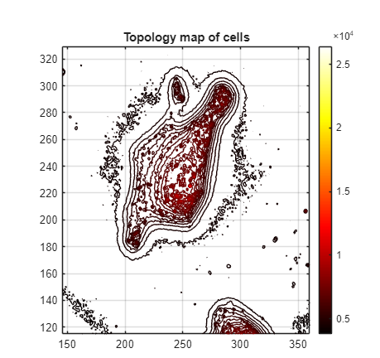
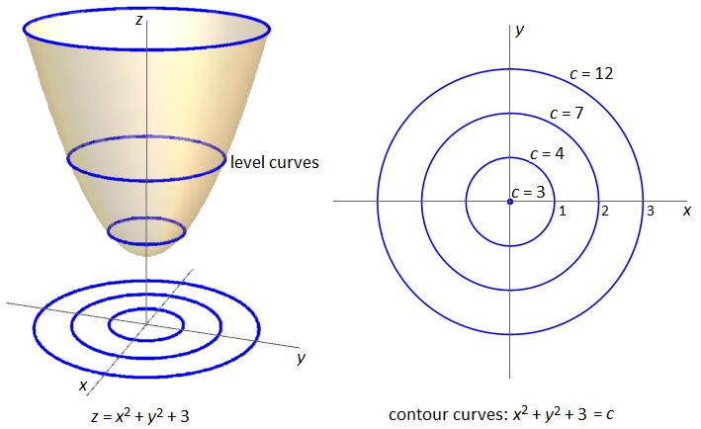
Program Premise
The program automatically detects cell outlines using topographical level curves
Create a hull around points of level curves and use as outline

Slide 4

Step 1: Create Max Projections
Open “Create_Max_Projections.m” in MATLAB 2025
Change folder name and identifiers and run
Max projections saved in sub folder of inputted folder named “Max Projections”
Creating max projections before running the cell outlining program will improve the load time greatly between images

Slide 5
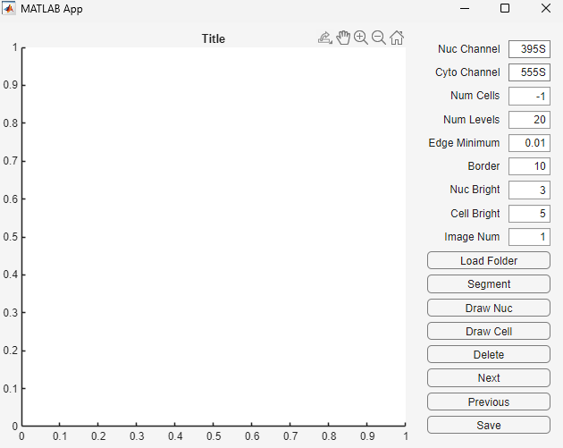
Step 2: Setup
In MATLAB 2025 type “appdesigner” in command bar
Open "Z:\Organized Codes\Automatic Cell Outlining\Automatic_Outlining_GUI.mlapp“
Input nucleus and cell channels you want to use for outlining
Testing done using mRNA as cell channel
Click “Load Folder”, and select folder containing max projections
Change “Image Num” to navigate to different image
3
4
5

Slide 6
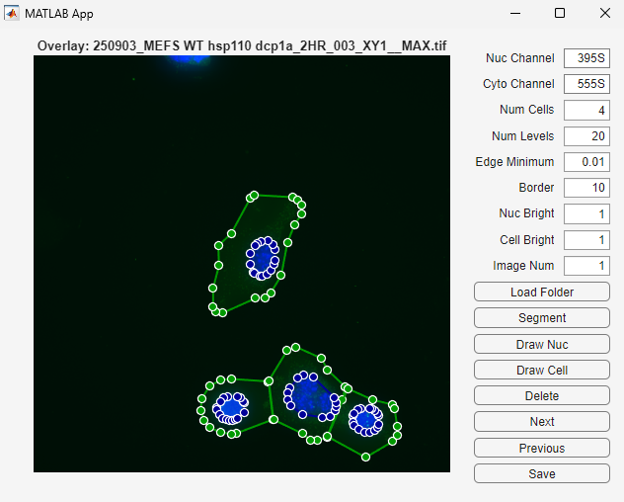
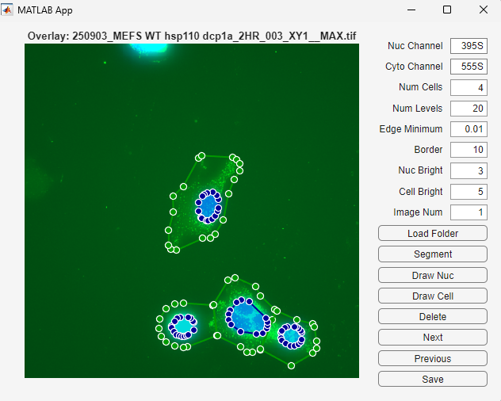
Step 3: Visualization of Images
Adjust “Nuc Bright” and “Cell Bright” to visualize image better

Slide 7
Step 4: Adjust Image Wide Parameters
“Num Cells” is an indicator of the number of cells detected in the image, not a parameter that can be changed
“Num Levels” dictates the number of level curves used for cell outlining, more level curves makes program more sensitive making larger cell areas
“Edge Minimum” dictates the minimum edge length between vertices in the cell outline, a smaller value will lead to more vertices and allow for more precise adjustment
“Border” dictates the minimum number of pixels away from border a detected nucleus must be to be outlined

Slide 8
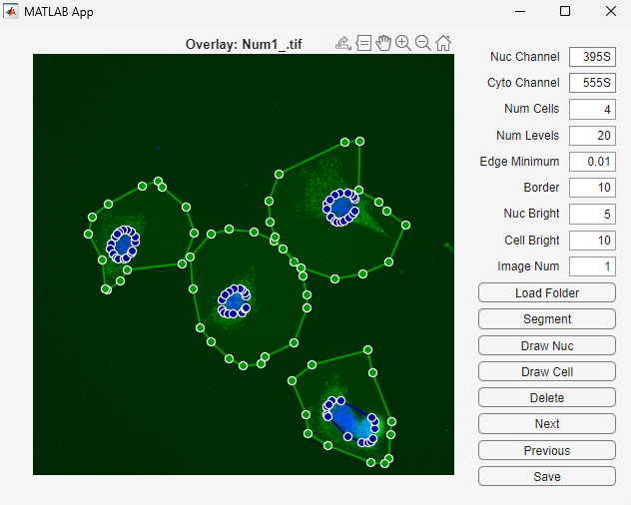
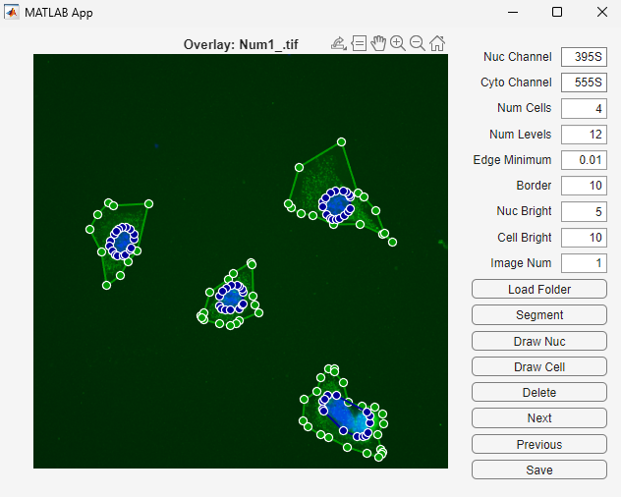
Step 4: Num Levels
More level curves means the segmentation will pick up lower intensity areas of cells
Fewer level curves means the segmentation will pick up less background

Slide 9
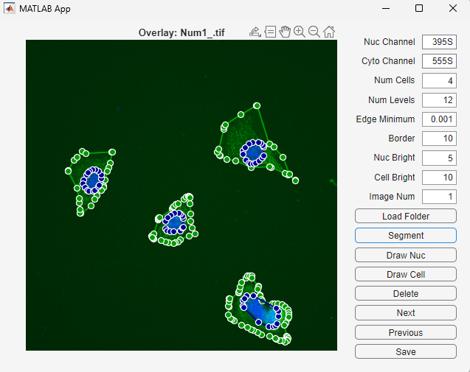
Step 4: Edge Minimum

Slide 10
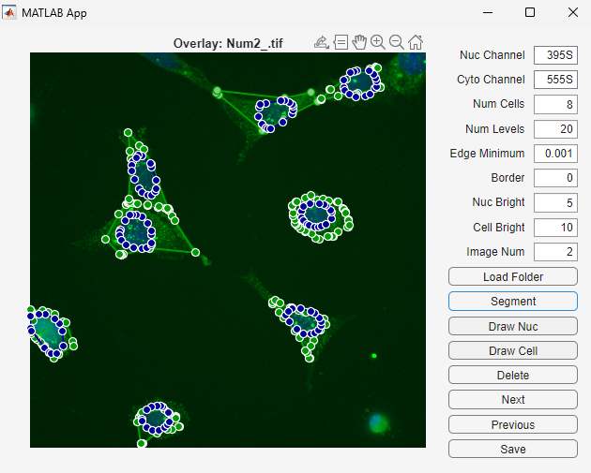
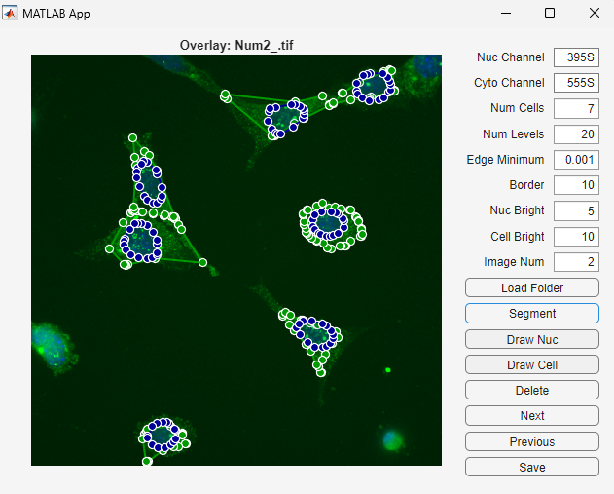
Step 4: Border

Slide 11
Step 5: Manual Adjustments
Delete existing cell and nucleus outlines that you do not want to include by pressing on them to select (turning them red) then pressing “Delete Selected”. Multiple cells can be selected at once. Alternatively select only the cells and nuclei you want to keep and press “Delete Unselected”
Fix outlines by dragging vertices into place
Draw new nucleus and cell outlines
Note: in the end the number of nucleus and cell outlines should be equal, nucleus outlines are fully contained within cell outlines, and there is no overlap between cell outlines

Slide 12
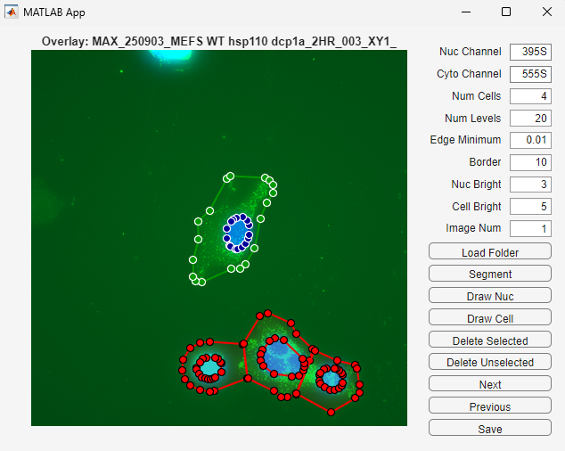
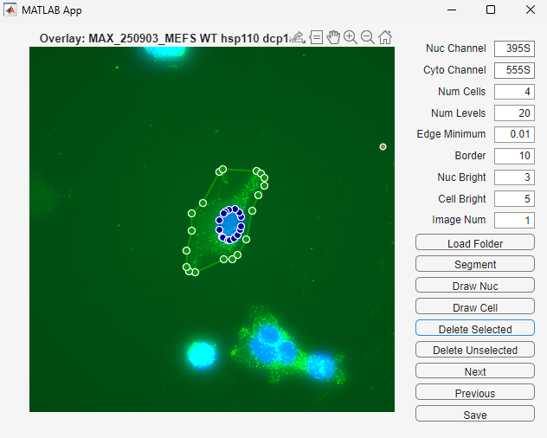
Step 5: Deleting Selected Cells

Slide 13
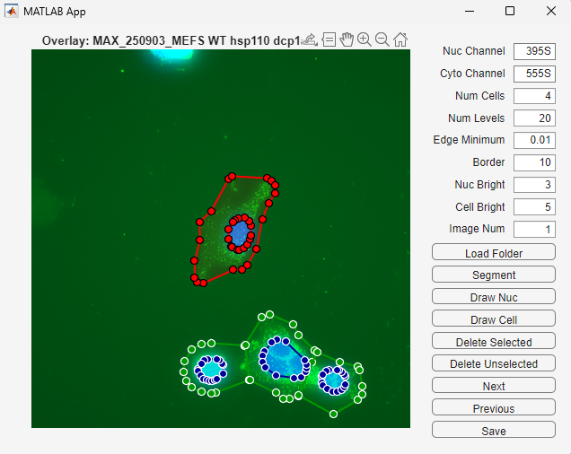

Step 5: Deleting Unselected Cells

Slide 14
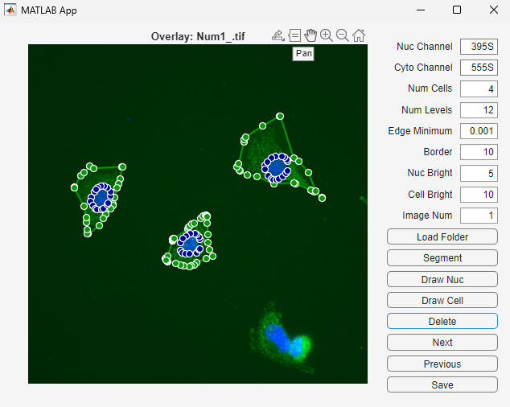
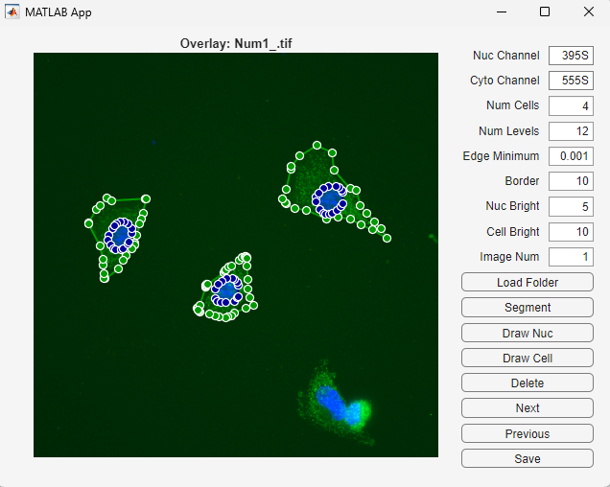
Step 5: Adjust Vertices

Slide 15
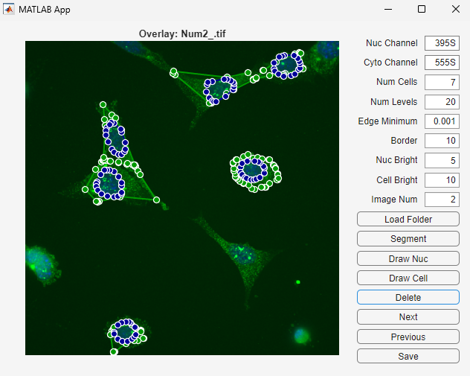
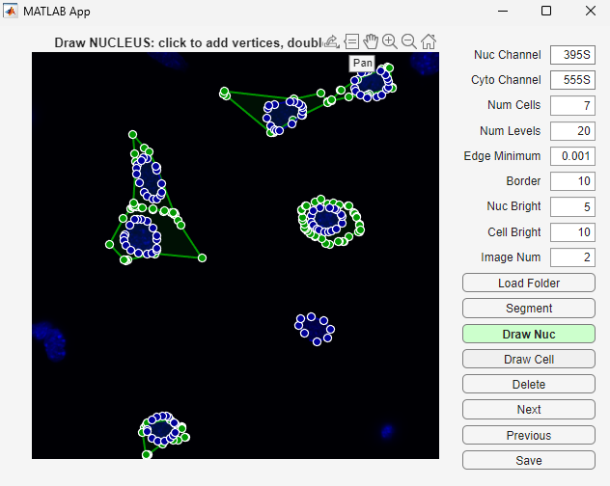
Step 5: Draw Nucleus
Clicking draw nucleus removes Cyto channel allowing better visualization of nucleus
Left click creates a new vertex, right click ends the nucleus outline

Slide 16
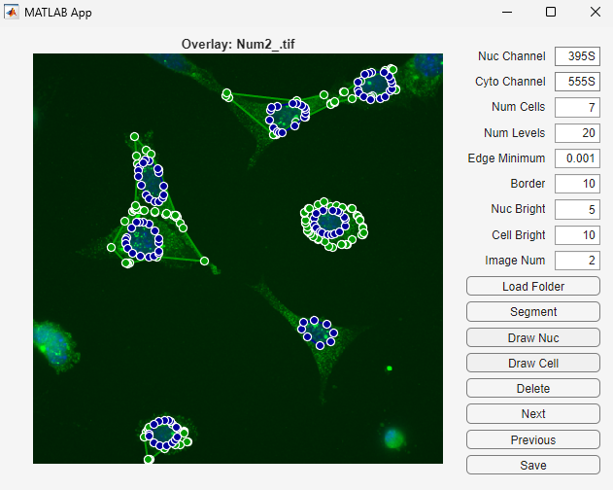
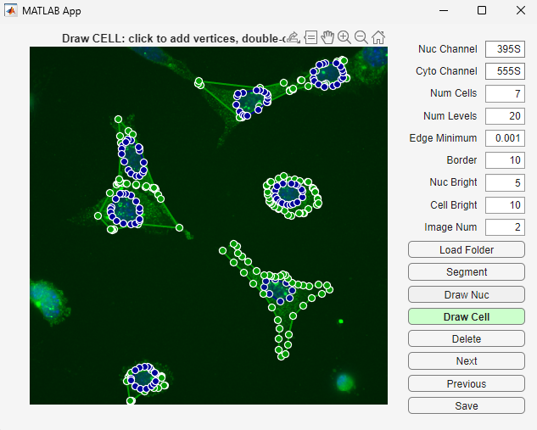
Step 5: Draw Cell
Left click creates a new vertex, right click ends the nucleus outline

Slide 17
Step 6: Save and Next Image
Once happy with the outlines press “Save”
Advance to next image using the “Next” button
Go back to a previous image using “Previous” button
Note: if you go to adjust an image after already saving results delete previous masks in folder before saving again
2
3
1

Slide 18
Questions?

Slide 19
CellSAM: a foundation model for cell segmentation (Marks et al.)

Slide 20
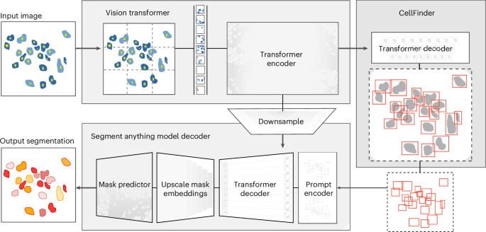
CellSAM Overview

Slide 21
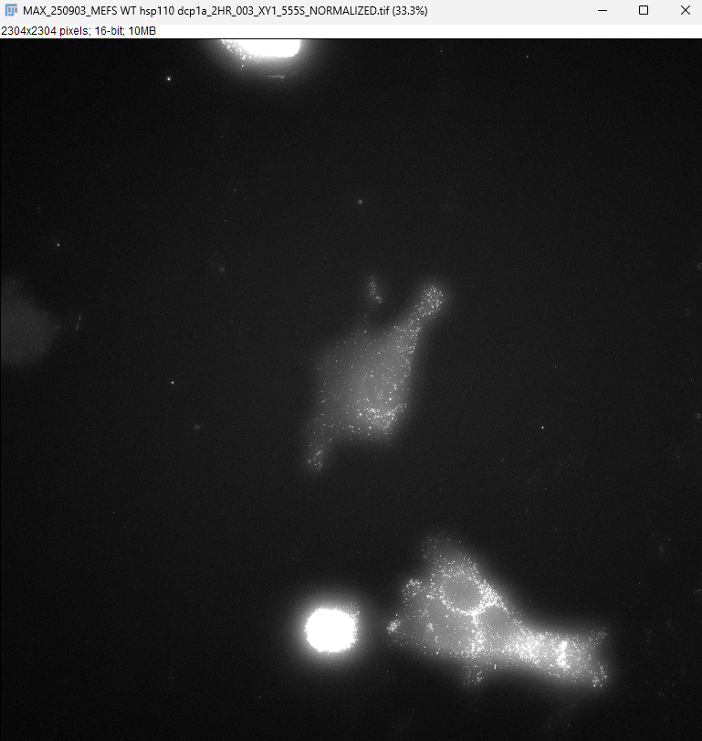
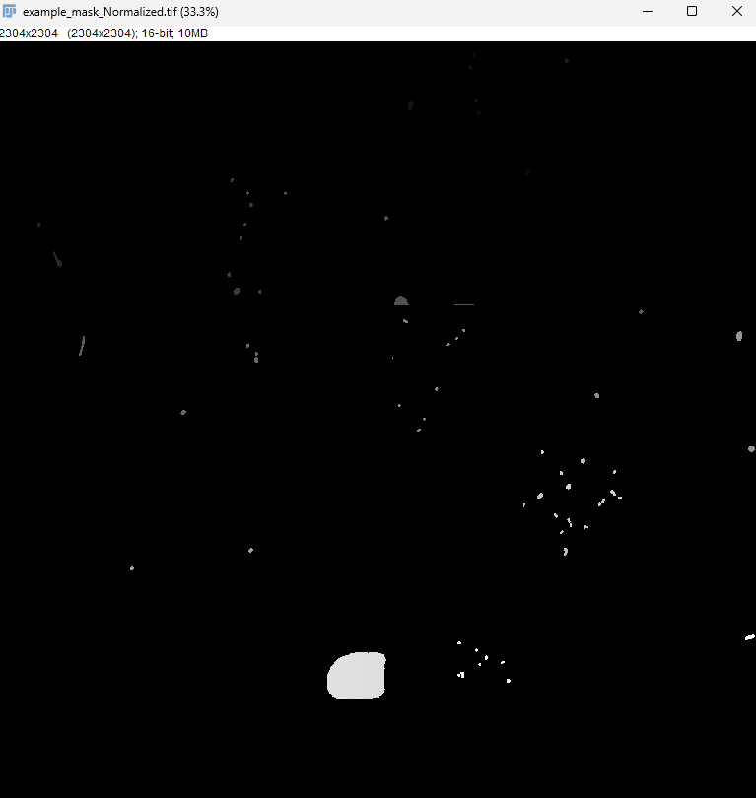
Example With Our smFISH Images

